Slide 1

Texture Filtering
CS 418: Interactive Computer Graphics
UNIVERSITY OF ILLINOIS AT URBANA-CHAMPAIGN
Eric Shaffer

Slide 2
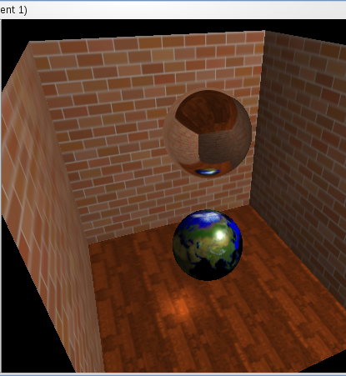
Reviewing Texture Coordinates
We’re using the following convention:
(u,v) are the texture coordinates assigned in the parametric space with u and v in [0,1]
(s,t) are the texel coordinates in a texture
….some people use (s,t) to denote the parametric coordinates…

Slide 3
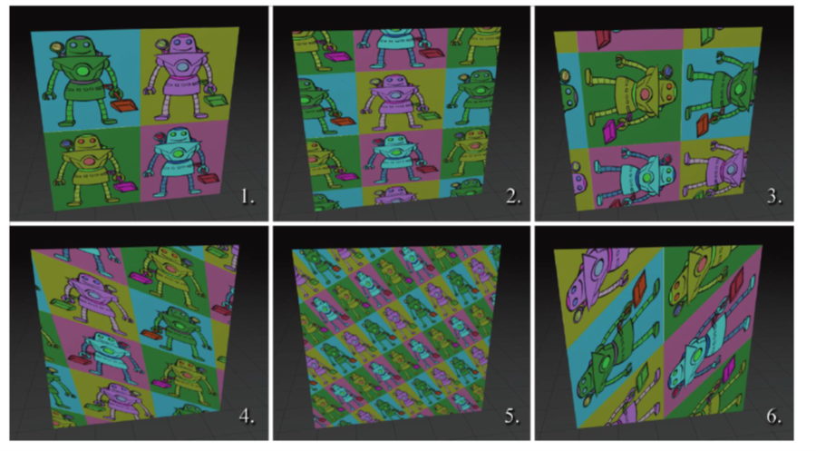
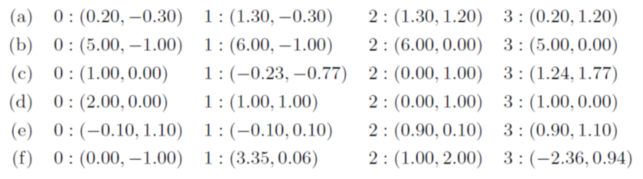
Match the Coordinates to the Image
Match each textured quad with the set of texture coordinates used to generate it given in the list below.

Slide 4
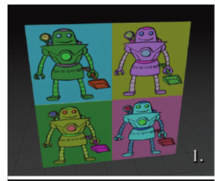
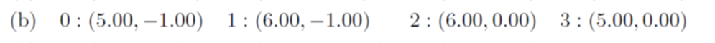
For example
The first image is axis aligned and doesn’t repeat
Only possible coordinates from list are
Which give axis-aligned edges
And parametric lengths of 1

Slide 5
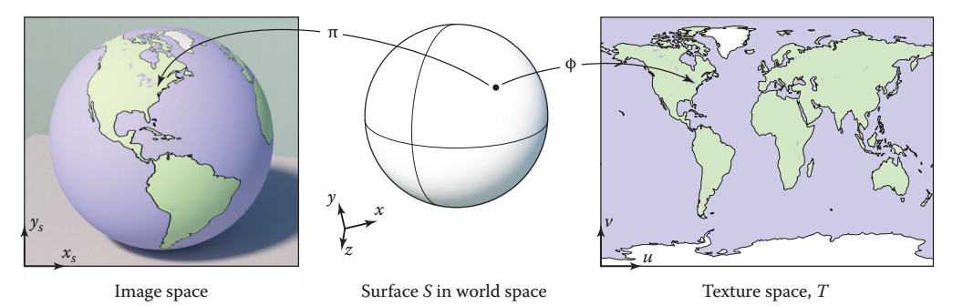
Texture Coordinates
We’ve only looked at simple mappings
Mapping the texture onto planar surfaces
More complicated surfaces need more complicated mappings

Slide 6
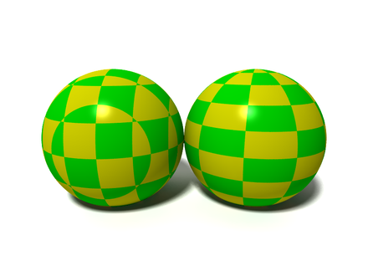
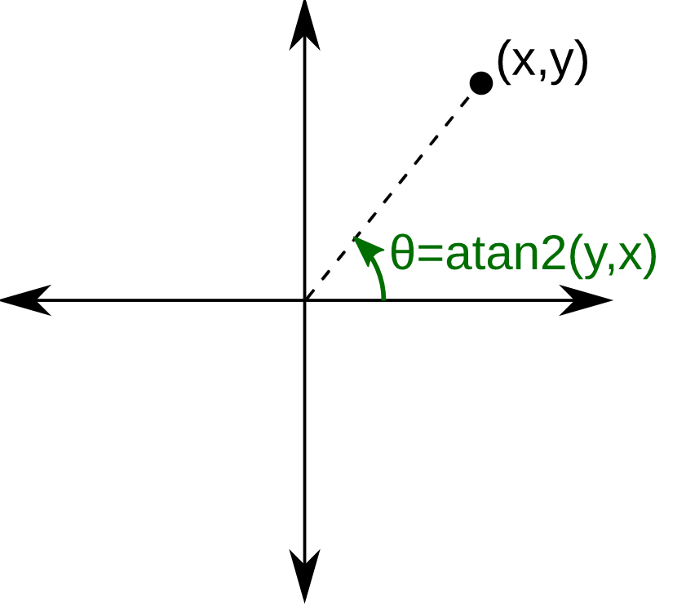
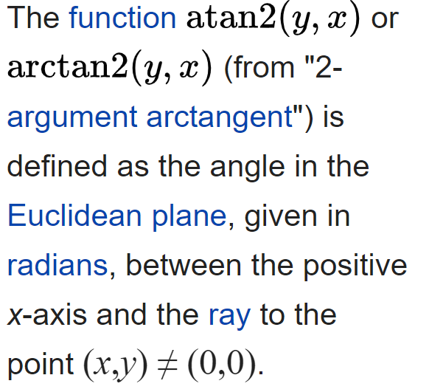
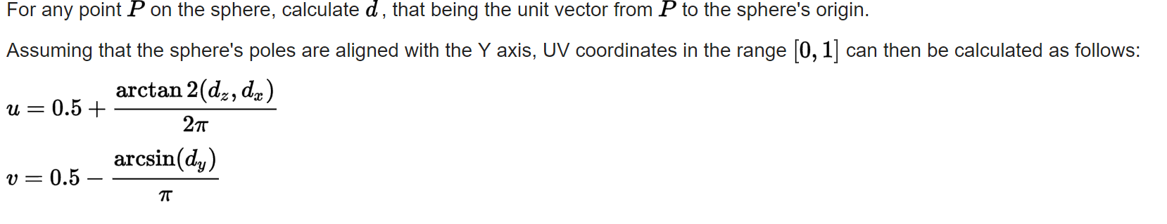
Example: Mapping onto a sphere
- Wikipedia
Sphere on the right uses:
How is the sphere on the left being textured?

Slide 7
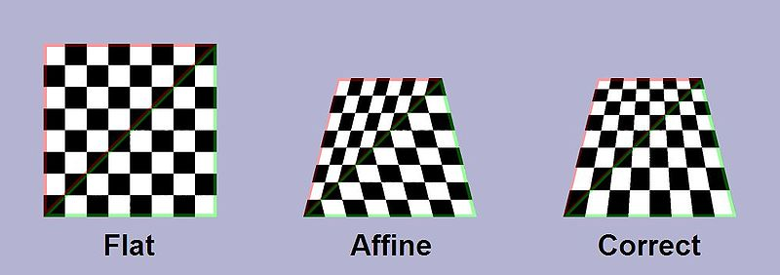
Perspective Correct Coordinates
Linear (affine) interpolation problematic for texture coordinates
Won’t produce perspective correct texture coordinates

Slide 8
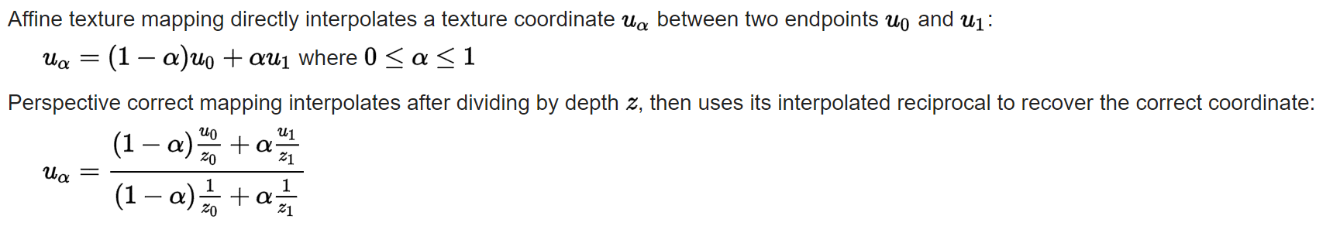
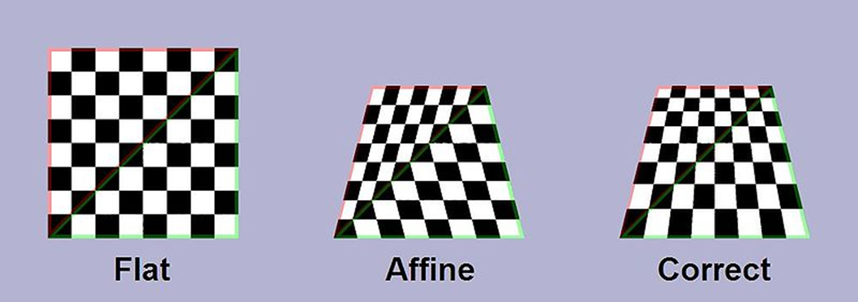
Perspective Correct Coordinates
-- Wikipedia

Slide 9
Texture Filtering
We often have a mismatch between texture size and number of fragments
Requires us to adjust how the texture is sampled…
This more complicated sampling process is called texture filtering
Magnification occurs when we have more fragments than texels
Minification occurs when we have more texels than fragments
Two common mag filters
Nearest Neighbor
Bilinear
Most common min filter
Mipmapping

Slide 10
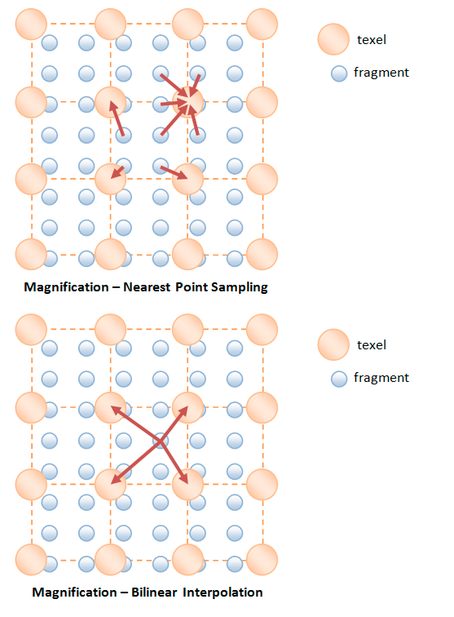
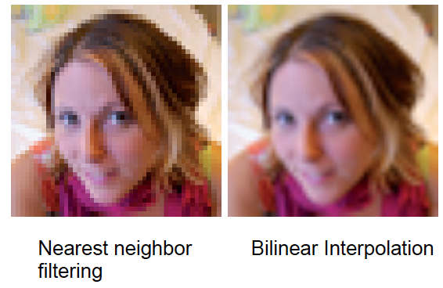
Magnification

Slide 11
Magnification: Nearest Neighbor

Slide 12
Magnification: Bilinear Interpolation
In bilinear interpolation, we estimate a value for a function
On a 2D grid…with function samples at the grid vertices
We interpolate first in one direction (e.g. the x direction)
Interpolate using linear interpolation twice
Find 2 points…one on each edge
Then interpolate in the other direction (e.g. the y direction)
Linear interpolation again
Between the two points from the first round of interpolation

Slide 13
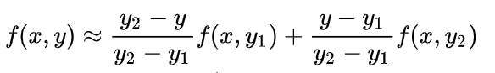
Magnification: Bilinear Interpolation

Slide 14
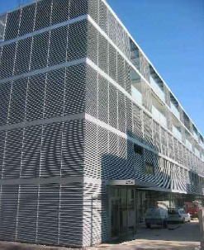
Filtering Textures
Minification occurs when we have more texels than fragments
Using NN or Bilinear Filtering can lead to aliasing
Why?
What would a better strategy be?
What is the maximum number of texels fetched per fragment?

Slide 15
Filtering Textures
Minification occurs when we have more texels than fragments
Using NN or Bilinear Filtering can lead to aliasing
Why?
Sparse sampling will can cause us to miss features
e.g. a checkerboard pattern could be turned into solid color
What would a better strategy be?
Average all of the texels that map into a fragment
What is the maximum number of texels fetched per fragment?
The entire texture

Slide 16
Minification

Slide 17
Mipmapping
Mipmapping is a method of pre-filtering a texture for minification
History: 1983 Lance Williams introduced the word “mipmap” in his paper “Pyramidal Parametrics”
mip = “multum in parvo”…. latin: many things in small place(?)
We generate a pyramid of textures
Bottom-level is the original texture
Each subsequent level reduces the resolution by ¼ (by ½ along s and t)

Slide 18
Mipmapping

Slide 19
Pre-filtered Image Versions
Base texture image is say 128x128
Then down-sample 64x64, 32x32, all the way down to 1x1
Trick: When sampling the texture, pick the mipmap level with the closest mapping of pixel to texel size
Why? Hardware wants to sample just a small (1 to 8) number of samples for every fetch—and want constant time access

Slide 20
Creating a Mipmap
In WebGL you can manually generate and upload a mipmap
Or you can have WebGL generate it for you
Usually, bilinear filtering is used to minify each level
…but that’s up to the implementation of the library
gl.generateMipmap(GL_TEXTURE_2d)

Slide 21
Level of Detail Selection

Slide 22
Mipmap Level-of-detail Selection
Hardware uses 2x2 pixel entities
Typically called quad-pixels or just quad
Finite difference with neighbors to get change in u and v with respect to window space
Approximation to ∂s/∂x, ∂s/∂y, ∂t/∂x, ∂t/∂y
Means 4 subtractions per quad (1 per pixel)
$$\frac{∂s}{∂x}=change in s coordinate over one unit change in horizontal direction$$
$$\frac{∂s}{∂y}=change in s coordinate over one unit change in vertical direction$$
$$\frac{∂t}{∂x}=change in t coordinate over one unit change in horizontal direction$$
one-pixel separation
$$\frac{∂t}{∂y}=change in t coordinate over one unit change in vertical direction$$

Slide 23
Mipmap Level-of-detail Selection
Hardware uses 2x2 pixel entities
Typically called quad-pixels or just quad
Finite difference with neighbors to get change in u and v with respect to window space
Approximation to ∂s/∂x, ∂s/∂y, ∂t/∂x, ∂t/∂y
Means 4 subtractions per quad (1 per pixel)
Now compute approximation to gradient length
p = max(sqrt((∂s/∂x)²+(∂t/∂x)²), sqrt((∂s/∂y)²+(∂t/∂y)²))
one-pixel separation

Slide 24
Level-of-detail Bias and Clamping
Convert p length to level-of-detail
λ = log₂(p)
Now clamp λ to valid LOD range
λ’ = max(minLOD, min(maxLOD, λ))

Slide 25
Determine Mipmap Levels
Determine lower and upper mipmap levels
b = floor(λ’)) is bottom mipmap level
t = floor(λ’+1) is top mipmap level
Determine filter weight between levels
w = frac(λ’) is filter weight

Slide 26
WebGL Computing a Color from a Mipmap
WebGL offers 6 ways to generate a color from a mipmap
NEAREST = choose 1 pixel from the biggest mip
LINEAR = choose 4 pixels from the biggest mip and blend them
NEAREST_MIPMAP_NEAREST = choose the best mip, then pick one pixel from that mip
LINEAR_MIPMAP_NEAREST = choose the best mip, then blend 4 pixels from that mip
NEAREST_MIPMAP_LINEAR = choose the best 2 mips, choose 1 pixel from each, blend them
LINEAR_MIPMAP_LINEAR = choose the best 2 mips. choose 4 pixels from each, blend them

Slide 27
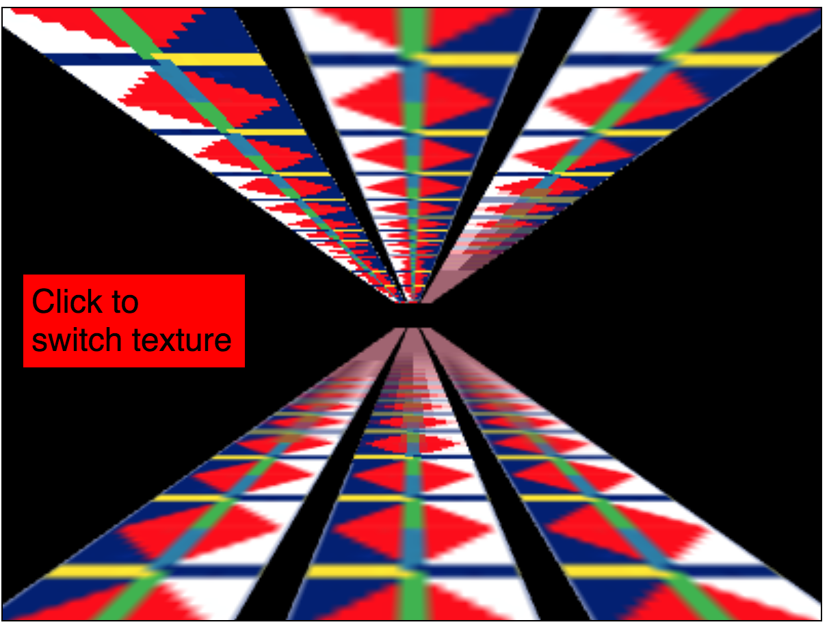
Mipmap Texture Filtering

Slide 28
WebGL: Highest Quality Filtering
gl.texParameteri(gl.TEXTURE_2D, gl.TEXTURE_MIN_FILTER, gl.LINEAR_MIPMAP_LINEAR);
gl.texParameteri(gl.TEXTURE_2D, gl.TEXTURE_MAG_FILTER, gl.LINEAR);
Although some WebGL implementations may now support anisotropic texture filtering…which is even better

Slide 29
WebGL: Non-power of 2 textures
You should use textures that are 2^{k} x 2^{k}
You can use textures that are not powers of two
but must
set the wrap mode to CLAMP_TO_EDGE
turn off mipmapping by setting filtering to LINEAR or NEAREST…

Slide 30
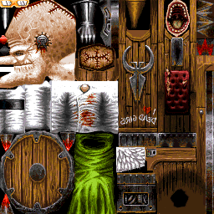
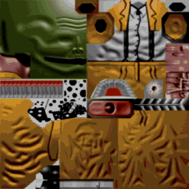
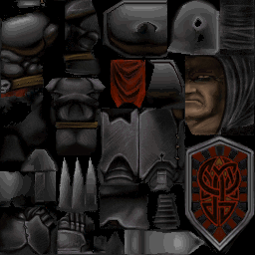
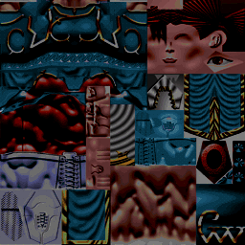
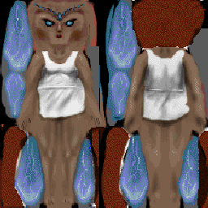
Texture Arrays
Multiple skins packed in texture array
Motivation: binding to one multi-skin texture array avoids texture bind per object
Texture array index
0
1
2
3
4
0
Mipmap level index
1
2
3
4

